Slide 1
C - Loops

Slide 2
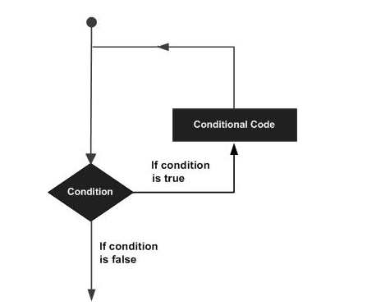
A loop statement allows us to execute a statement or group of statements multiple times.

Slide 3
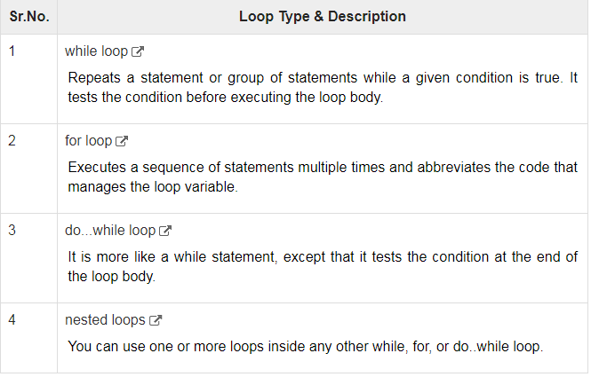
C programming language provides the following types of loops to handle looping requirements.

Slide 4
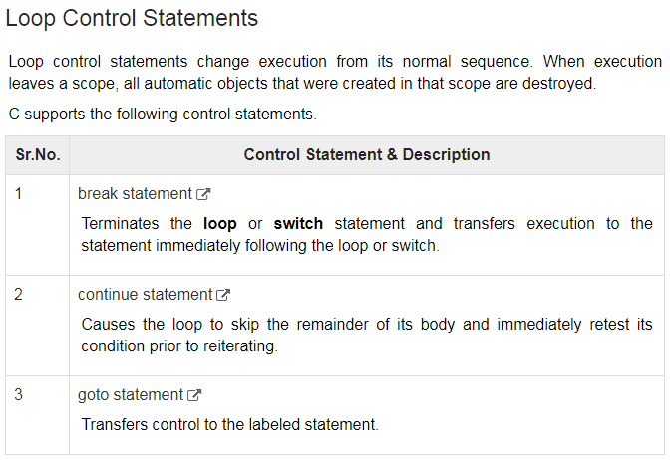

Slide 5
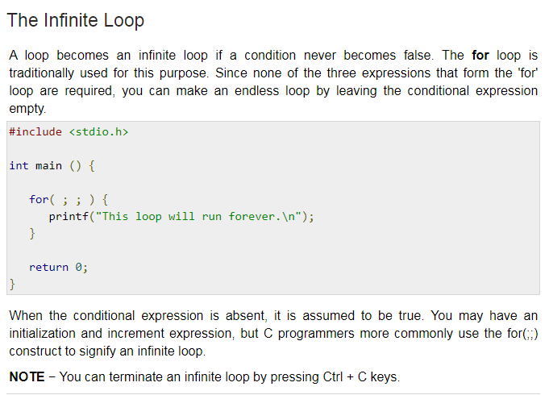

Slide 6
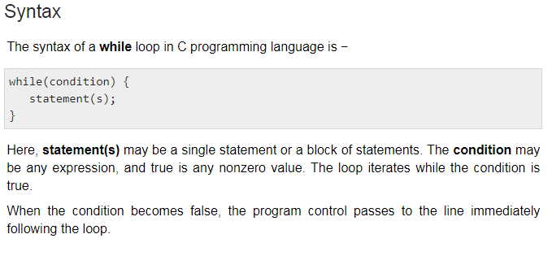
A while loop in C programming repeatedly executes a target statement as long as a given condition is true.

Slide 7
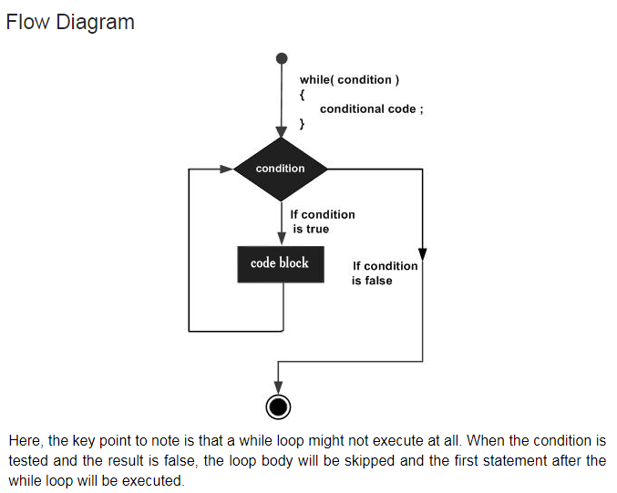

Slide 8
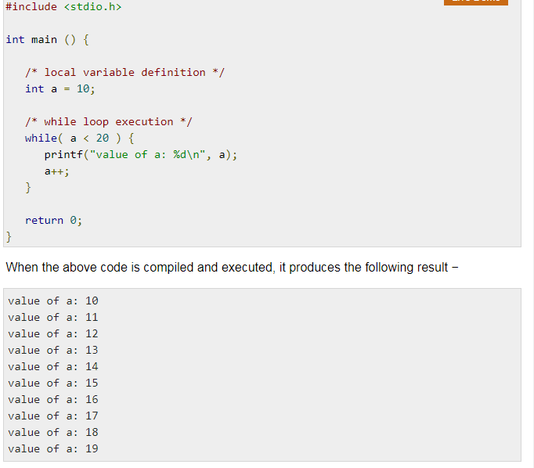

Slide 9
for loop in C- A for loop is a repetition control structure that allows you to efficiently write a loop that needs to execute a specific number of times.
for ( init; condition; increment )
{
statement(s);
}

Slide 10
The init step is executed first, and only once. This step allows you to declare and initialize any loop control variables. You are not required to put a statement here, as long as a semicolon appears.
Next, the condition is evaluated. If it is true, the body of the loop is executed. If it is false, the body of the loop does not execute and the flow of control jumps to the next statement just after the 'for' loop.
After the body of the 'for' loop executes, the flow of control jumps back up to the increment statement. This statement allows you to update any loop control variables. This statement can be left blank, as long as a semicolon appears after the condition.
The condition is now evaluated again. If it is true, the loop executes and the process repeats itself (body of loop, then increment step, and then again condition). After the condition becomes false, the 'for' loop terminates.

Slide 11
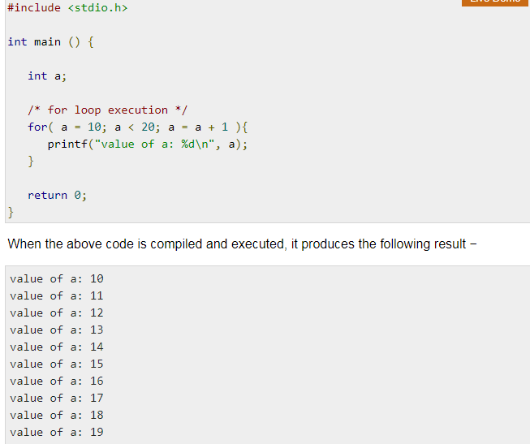

Slide 12
#include <stdio.h>
int main () {
int a; /* for loop execution */
a = 10;
for( ;a < 20; )
{
printf("value of a: %d\n", a);
a = a + 1;
}
return 0;}

Slide 13
do...while loop in C
Unlike for and while loops, which test the loop condition at the top of the loop, the do...while loop in C programming checks its condition at the bottom of the loop.
A do...while loop is similar to a while loop, except the fact that it is guaranteed to execute at least one time.
do {
statement(s);
} while( condition );
Notice that the conditional expression appears at the end of the loop, so the statement(s) in the loop executes once before the condition is tested.
If the condition is true, the flow of control jumps back up to do, and the statement(s) in the loop executes again. This process repeats until the given condition becomes false.

Slide 14
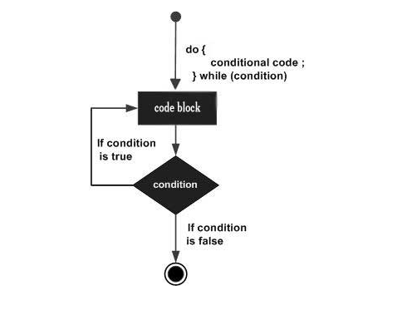

Slide 15
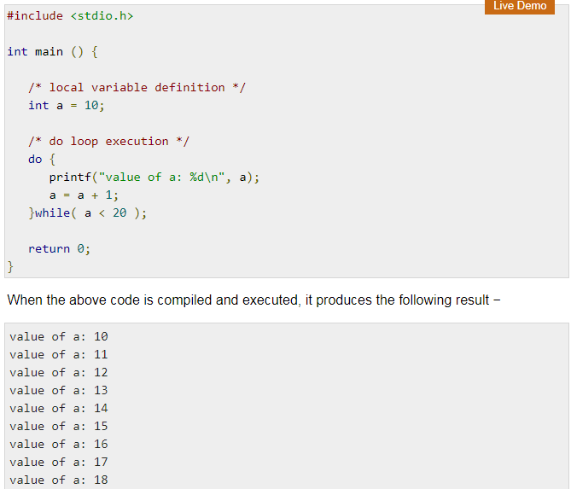

Slide 16
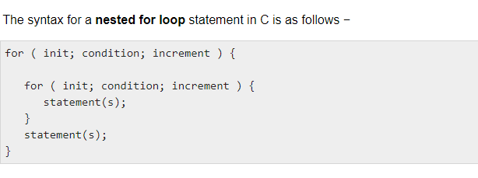
nested loops in C C programming allows to use one loop inside another loop

Slide 17
